Slide 1
Questions answered
Dart edition

Slide 2
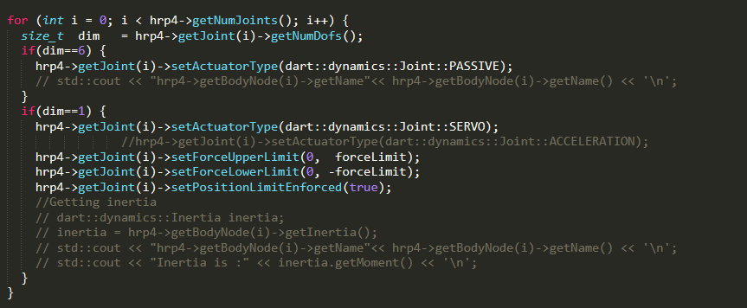
Question 1 : why ignore the first 6 DOFs
Main.cpp

Slide 3
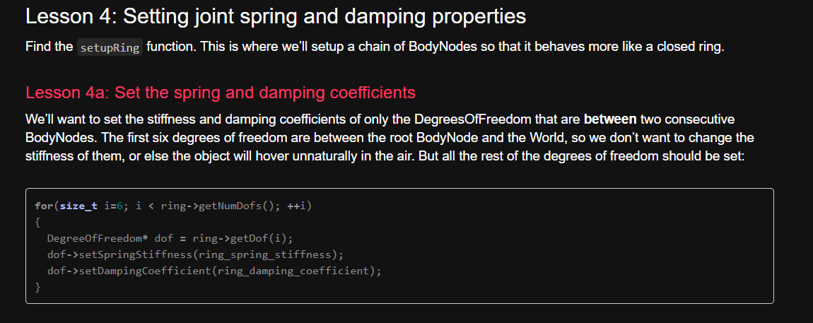
Answer 1 (1/2): Because this
http://dartsim.github.io/tutorials_collisions.html#lesson-4a-set-the-spring-and-damping-coefficients

Slide 4
Answer 1 (2/2)
This is because we want to fix the first joint to the world frame so that it doesn’t act unnaturally?

Slide 5

Question 2 : where does main file call the update() method of the controller.cpp class
Controller.cpp

Slide 6
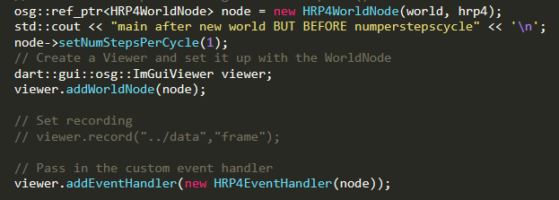
Answer 2:
The answer is the first line of this code of the main.cpp file, it calls the HRP4WorldNode which is a child of
main.cpp

Slide 7
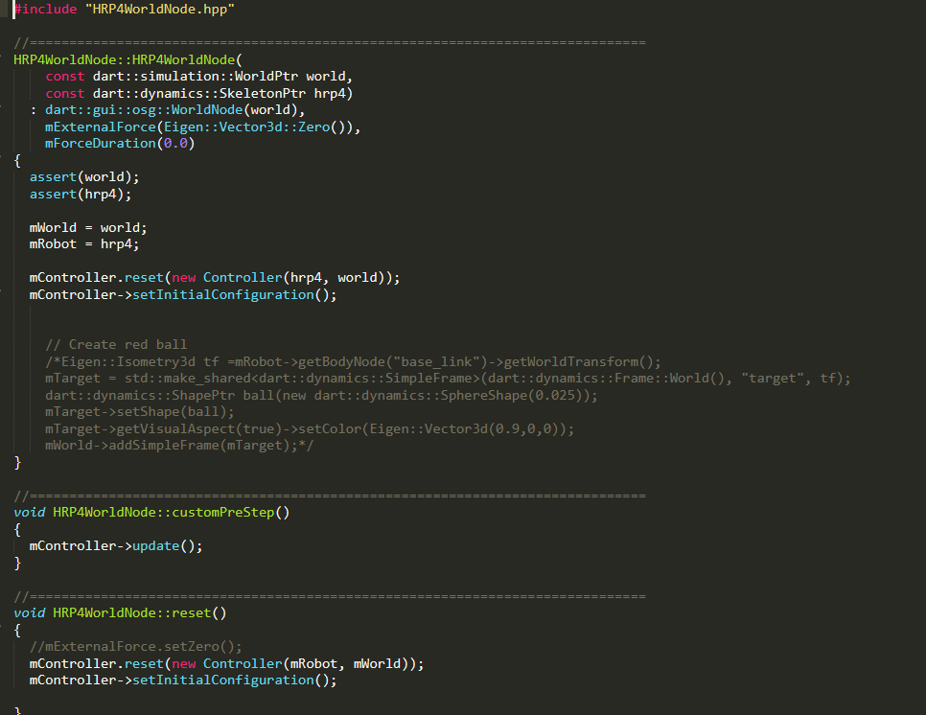
Answer 2:
Here is the class HRP4WorldNode which we create an instance of in the main.cpp file.
First we set the world and the hrp4 robot.
Then we reset the controller and instantiating a controller, which we go through the constructor of the controller class and initialize all the controller stuff.
HRP4WorldNode.cpp

Slide 8
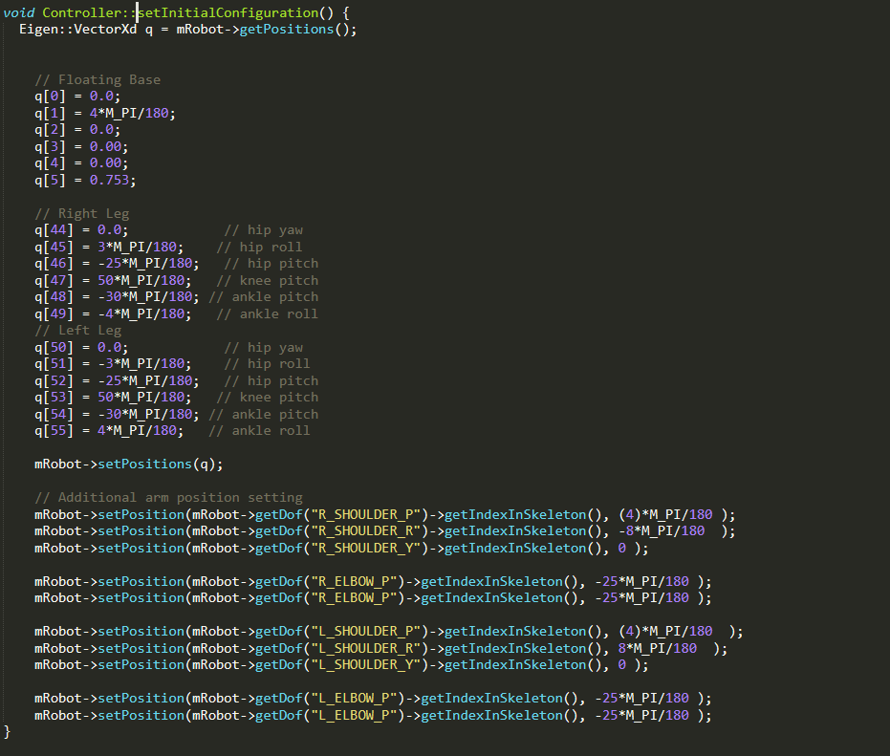
Answer 2:
3. Then we call this method from the controller.cpp class which initializes the controller with initial conditions.
HRP4WorldNode.cpp

Slide 9


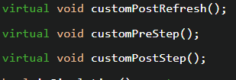
Answer 2:
4. Then we have this method in the class which is not called.
But we see that in hrp4worldnode.hpp, this is override, so there is the exact method in the parent WorldNode by DART.
https://dartsim.github.io/dart/v6.9.5/d2/d1e/WorldNode_8hpp_source.html
HRP4WorldNode.cpp

Slide 10
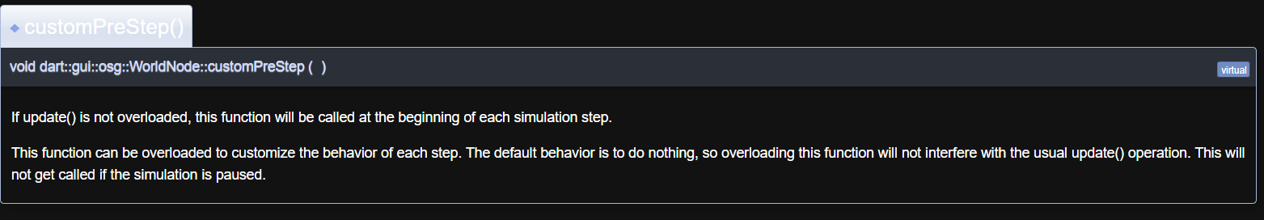
Answer 2:
Then we see this in the documentation. It is not clear here that (FIXME) what update() here means? Does it mean that there is a controller class in DART that has update() which we overload?
HRP4WorldNode.cpp

Slide 11
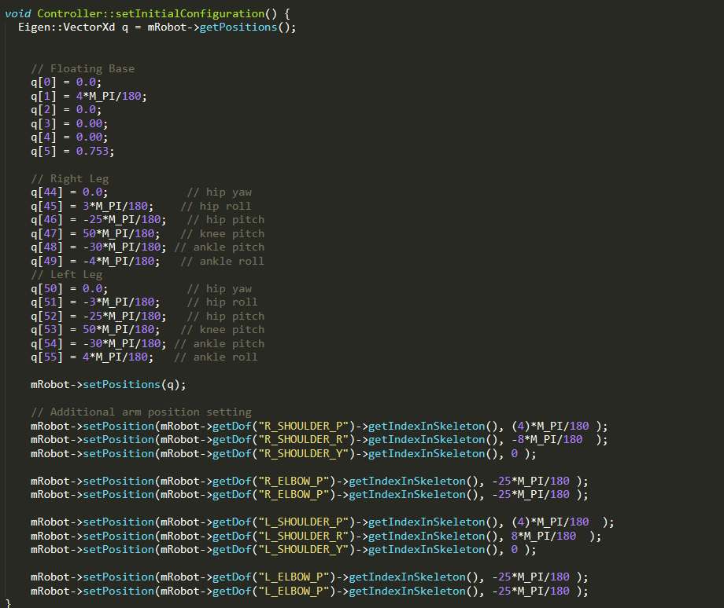
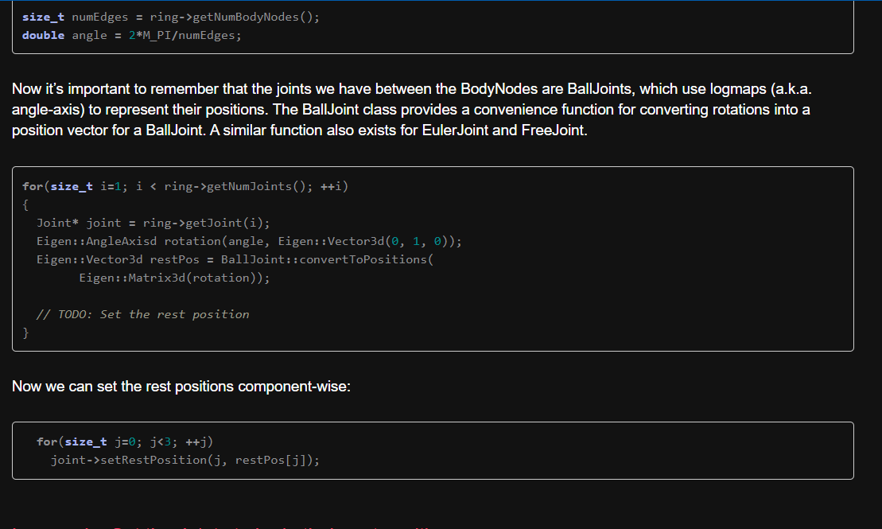
Question 3(suggestion):
It would be better to use setRestPosition() like in the tutorial:
http://dartsim.github.io/tutorials_collisions.html#lesson-4c-set-the-joints-to-be-in-their-rest-positions
Controller.cpp

Slide 12
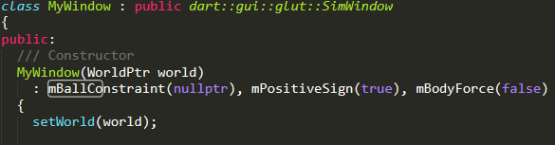
Question 4(tawdee7):
Tutorial multi-pendulum (main.cpp)
This is the mballconstraint that we use in the dynamical constraint. This is in the protected area of class MyWindow which is a child of Simwindow. It is initialized as a nullptr in the public area of the class as follows:

